Slide 1
Requirements Engineering and Management
Module 1 Requirements Management and Problem Analysis
K Sathyarajasekaran,
VIT Chennai

Slide 2
The Requirements Problem
The goal of software development is to develop quality software—on time and on budget—that meets customers' real needs.
Project success depends on effective requirements management.
Requirements errors are the most common type of systems development error and the most costly to fix.
A few key skills can significantly reduce requirements errors and thus improve software quality.

Slide 3
The Root Causes of Project Success and Failure
The 1994 Standish Group study noted the three most commonly cited factors that caused projects to be "challenged":
Lack of user input: 13 percent of all projects
Incomplete requirements and specifications: 12 percent of all projects
Changing requirements and specifications: 12 percent of all projects

Slide 4
The Root Causes of Project Success and Failure
What were the primary "success factors" for those projects?
User involvement: 16 percent of all successful projects
Executive management support: 14 percent of all successful projects
Clear statement of requirements: 12 percent of all successful projects

Slide 5
The two largest problems, appearing in about half the responses
Requirements specifications
Managing customer requirements

Slide 6
Summary
Requirements errors are likely to be the most common class of error.
Requirements errors are likely to be the most expensive errors to fix.
Conclusion
Requirements errors are likely to consume 25 percent to 40 percent of the total project budget.

Slide 7
Introduction to Requirements Management
A requirement is a capability that is imposed on the system.
Requirements management is a process of systematically eliciting, organizing, and documenting requirements for a complex system.
Our challenge is to understand users' problems in their culture and their language and to build systems that meet their needs.
A feature is a service that the system provides to fulfill one or more stakeholder needs.
A use case describes a sequence of actions, performed by a system, that yields a result of value to a user.

Slide 8
What Is a Software Requirement?
A software capability needed by the user to solve a problem to achieve an objective
A software capability that must be met or possessed by a system or system component to satisfy a contract, standard, specification, or other formally imposed documentation

Slide 9
What Is Requirements Management?
a systematic approach to eliciting, organizing, and documenting the requirements of the system, and a process that establishes and maintains agreement between the customer and the project team on the changing requirements of the system.

Slide 10
Requirements Management Techniques
Information systems and other applications developed for use within a company
Software developed and sold as commercial products
Software that runs on computers embedded in other devices, machines, or complex systems

Slide 11
The Road Map
Since we are embarking on a journey to develop quality software—on time and on budget—that meets customers' real needs, it may well be helpful to have a map of the territory.
The Problem Domain
Stakeholder Needs
Moving Toward the Solution Domain
Features of the System
Software Requirements

Slide 12
The Road Map
Since we are embarking on a journey to develop quality software—on time and on budget—that meets customers' real needs, it may well be helpful to have a map of the territory.
The Problem Domain
Stakeholder Needs
Moving Toward the Solution Domain
Features of the System
Software Requirements

Slide 13
Summary
Overview of the problem domain and the solution domain
Needs
Features
Software Requirements
Needs- Problem domain
Features- Solution domain
Software Requirements- solution domain

Slide 14
Requirements and the Software Lifecycle
The team's development process defines who is doing what, when, and how.
In the waterfall model, software activities proceeded through a sequence of steps, and requirements were "fixed" early.
In the spiral model, the first steps were taken to a more risk-driven and incremental approach to development.
The iterative approach, a hybrid of the waterfall and spiral models, decouples the lifecycle phases from the software activities that take place in each phase.
The iterative model is a more robust model and provides for successive refinement of the requirements over time.

Slide 15
Waterfall model of software development

Slide 16
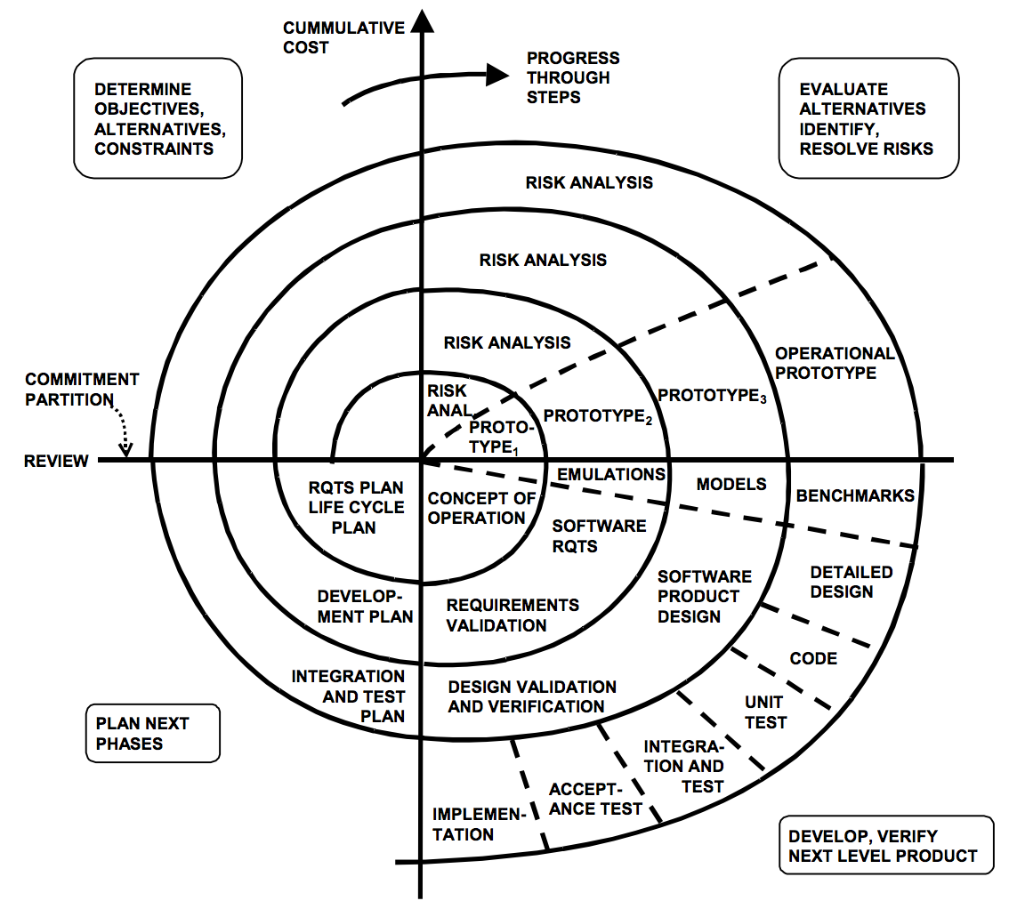
The spiral model of development

Slide 17

Lifecycle phases in the iterative approach

Slide 18
Requirements in the Iterative Model
requirements management perspective, the iterative approach provides two major advantages.
Better adaptability to requirements change.
Better scope management.

Slide 19
The Five Steps in Problem Analysis
Gain agreement on the problem definition.
Understand the root causes—the problem behind the problem.
Identify the stakeholders and the users.
Define the solution system boundary.
Identify the constraints to be imposed on the solution.

Slide 20
Step 1: Gain Agreement on the Problem Definition
Element | Description
The problem of . . . | Describe the problem.
Affects . . . | Identify stakeholders affected by the problem.
And results in . . . | Describe the impact of this problem on stakeholders and business activity.
Benefits of a solution . . . | Indicate the proposed solution and list a few key benefits.

Slide 21
Step 2: Understand the Root Causes—The Problem Behind the Problem

Slide 22
Step 3: Identify the Stakeholders and the Users
Who are the users of the system?
Who is the customer (economic buyer) for the system?
Who else will be affected by the outputs the system produces?
Who will evaluate and approve the system when it is delivered and deployed?
Are there any other internal or external users of the system whose needs must be addressed?
Who will maintain the new system?
Is there anyone else who cares?

Slide 23
Step 4: Define the Solution System Boundary

Slide 24
Step 5: Identify the Constraints to Be Imposed on the Solution
Source | Sample Considerations
Economics | What financial or budgetary constraints apply? Are there costs of goods sold or any product pricing considerations? Are there any licensing issues?
Politics | Do internal or external political issues affect potential solutions? Are there any interdepartmental problems or issues?
Technology | Are we restricted in our choice of technologies? Are we constrained to work within existing platforms or technologies? Are we prohibited from using any new technologies? Are we expected to use any purchased software packages?
Systems | Is the solution to be built on our existing systems? Must we maintain compatibility with existing solutions? What operating systems and environments must be supported?
Environment | Are there environmental or regulatory constraints? Are there legal constraints? What are the security requirements? What other standards might restrict us?
Schedule and resources | Is the schedule defined? Are we restricted to existing resources? Can we use outside labor? Can we expand resources? Temporarily? Permanently?

Slide 25
Summary
A good understanding of the problem to be solved and the root causes of the problem
Proper identification of the stakeholders whose collective judgment will ultimately determine the success or failure of our system
An understanding of where the boundaries of the solution are likely to be found
An understanding of the constraints and the degrees of freedom we have to solve the problem

